Slide 1


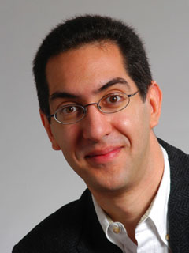
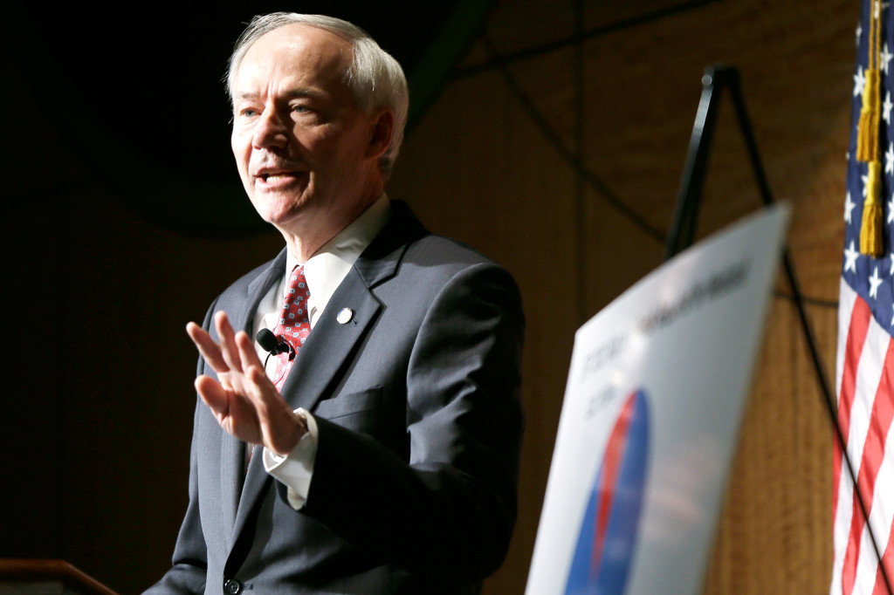
Arkansas leading K-12 CS initiatives!
UC Berkeley EECS Teaching Professor Dan Garcia
The Beauty and Joy of Computing Lecture #17
Higher Order Functions
Arkansas became the first state to pass a law requiring all K-12 public and charter schools to offer CS! Unlike Texas (which passed a similar act but didn’t fund it), this one is funded at $5M (small, but still) and pays for teacher training and incentives for schools that enroll kids.
www.wired.com/2015/03/arkansas-computer-science

Slide 2
Higher Order Functions… Why? Basics…

Slide 3
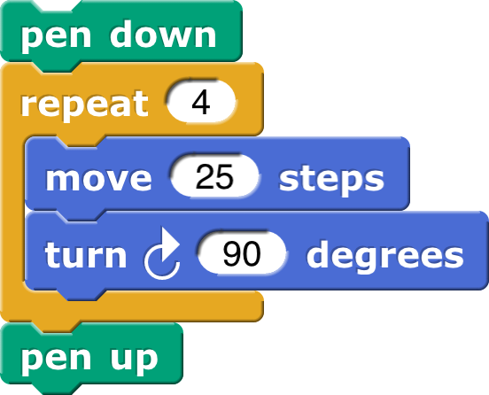
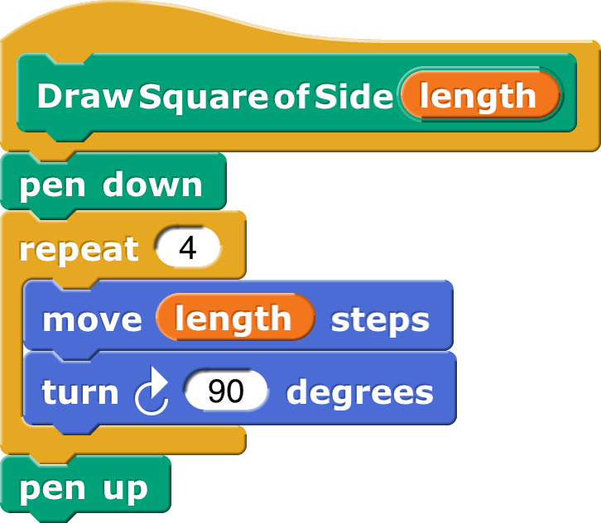
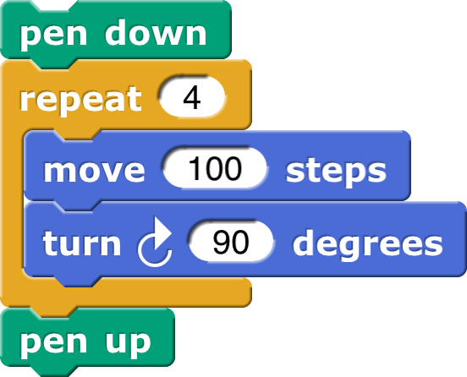
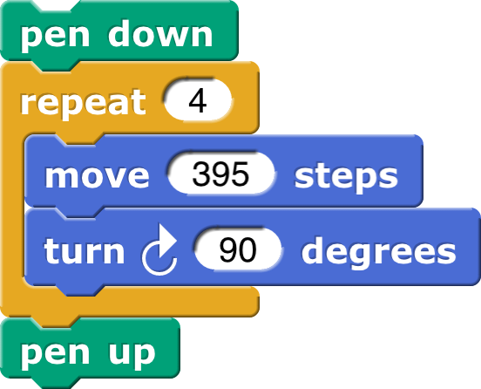

Why Use Functions? (review)
Calling it…

Slide 4

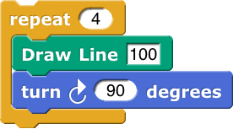
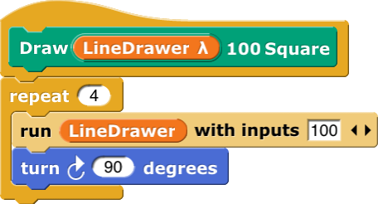
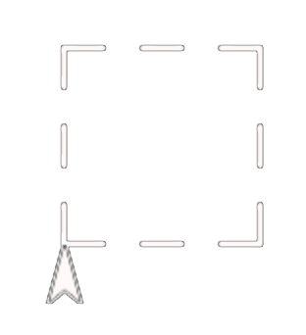
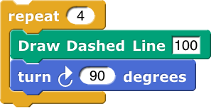

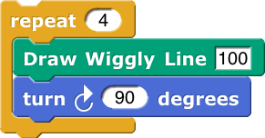

Why Use Higher-Order Functions?
Calling it…

Slide 5
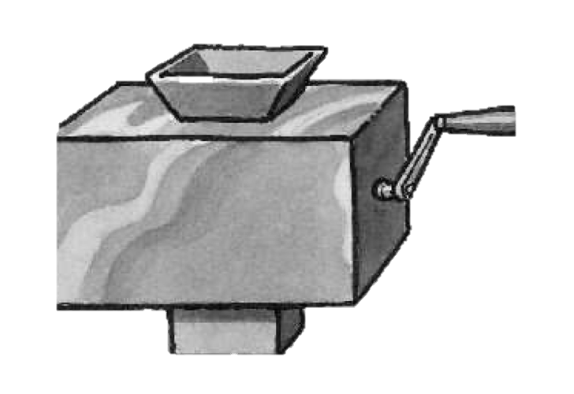
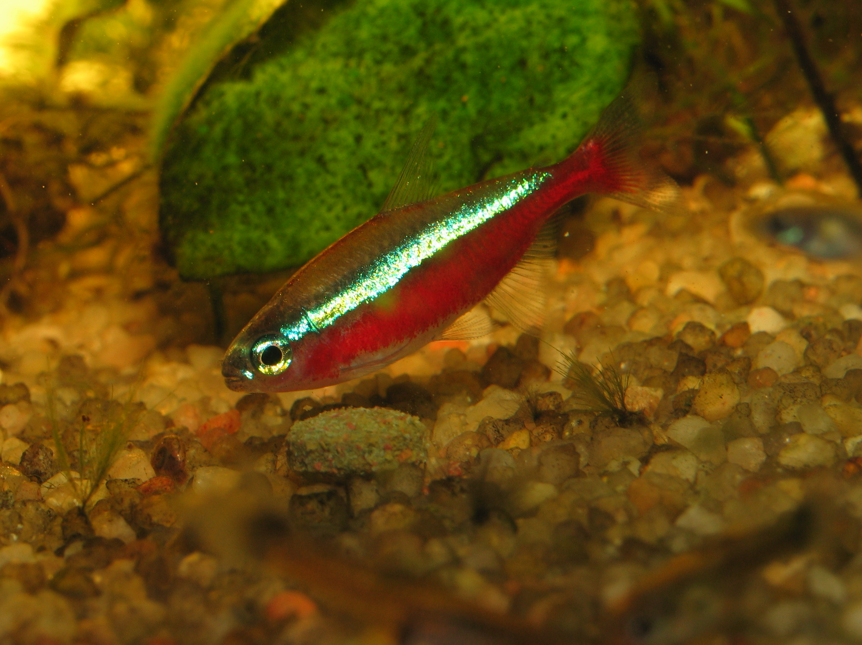
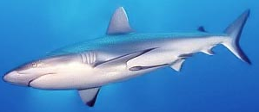
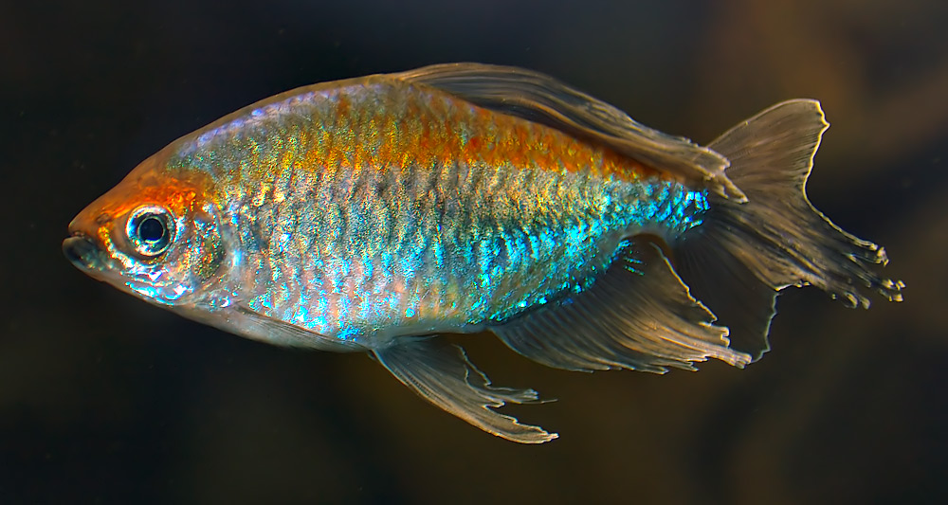
Why HOFs are like Pregnant Fish, Sharks
Data (e.g,. Sentences, Words, Booleans, Lists)
Functions
Normal Fish
Sharks
Data (e.g,. Sentences, Words, Booleans, Lists)
Data (e.g,. Sentences, Words, Booleans, Lists)
Data (e.g,. Sentences, Words, Booleans, Lists)
Functions
Pregnant Fish
Pregnant
Sharks
Functions
Functions
Source: Brian Harvey, Wikipedia (Fbattail, Aka, Evdaimon)

Slide 6
HOFs you have seen before
Useful HOFs (you can build your own!)
map Reporter over List
Report a new list, every element E of List becoming Reporter(E)
keep items s.t. Predicate from List
Report a new list, keeping only elements E of List if Predicate(E)
combine with Reporter over List
Combine all the elements of List with Reporter(E)
This is also known as “reduce”

Slide 7
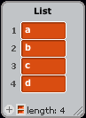




How combine works:
combine with Reporter over List
c
d
b
a

Slide 8


combine above the abstraction line
(a b c d)
combine using f
a f b f c f d
Your f should be associative, and work if it’s
((a f b) f (c f d))
or…
(((a f b) f c) f d)
☑
etc…

Slide 9
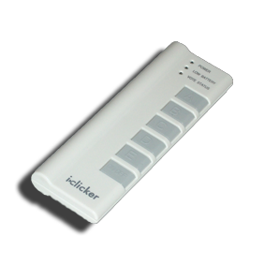
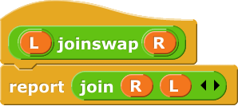
(Cal) Clicker Question
What is reported here?
abcd
acdb
bdac
dcba
(nothing)
Notes:
Data and information is hard to define. There are philosophical and meta-physical issues. So let’s all watch the Matrix…

Slide 10
Acronym

Slide 11
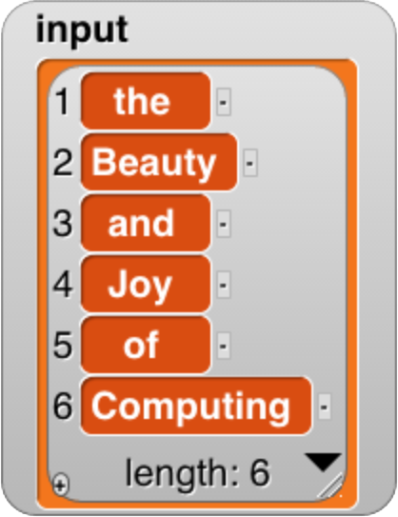
Acronym Algorithm
(the Beauty and Joy of Computing)
keep only uppercase words
(Beauty Joy Computing)
map first letter only
(B J C)
combine into one word (join)
BJC

Slide 12
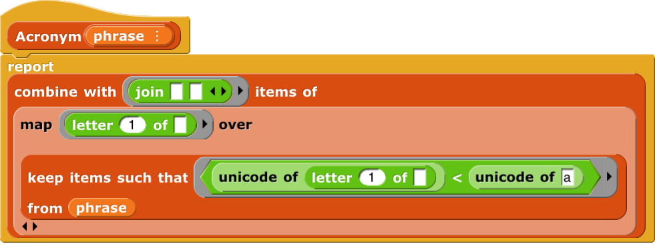
Acronym (uses map, keep, combine)
☑

Slide 13
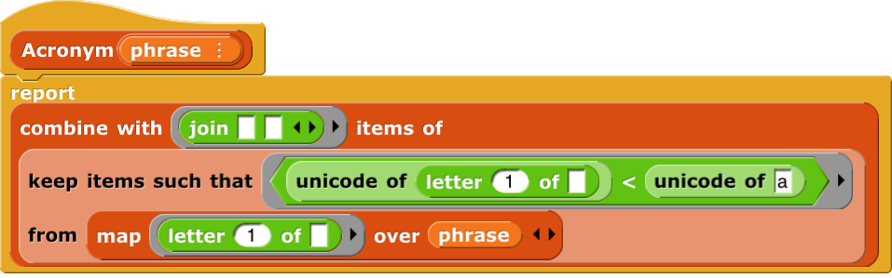
(Cal) Clicker Question
What is reported if I swap keep and map in Acronym and call it on (the Beauty and Joy of Computing)
bjc
BJC
CJB
(nothing)
Error
Notes:
Data and information is hard to define. There are philosophical and meta-physical issues. So let’s all watch the Matrix…

Slide 14
HOF Tools & Demo

Slide 15
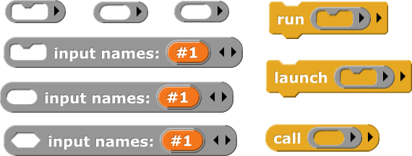
HOF tools, sharks, pregnant fish, mymap

